Slide 1
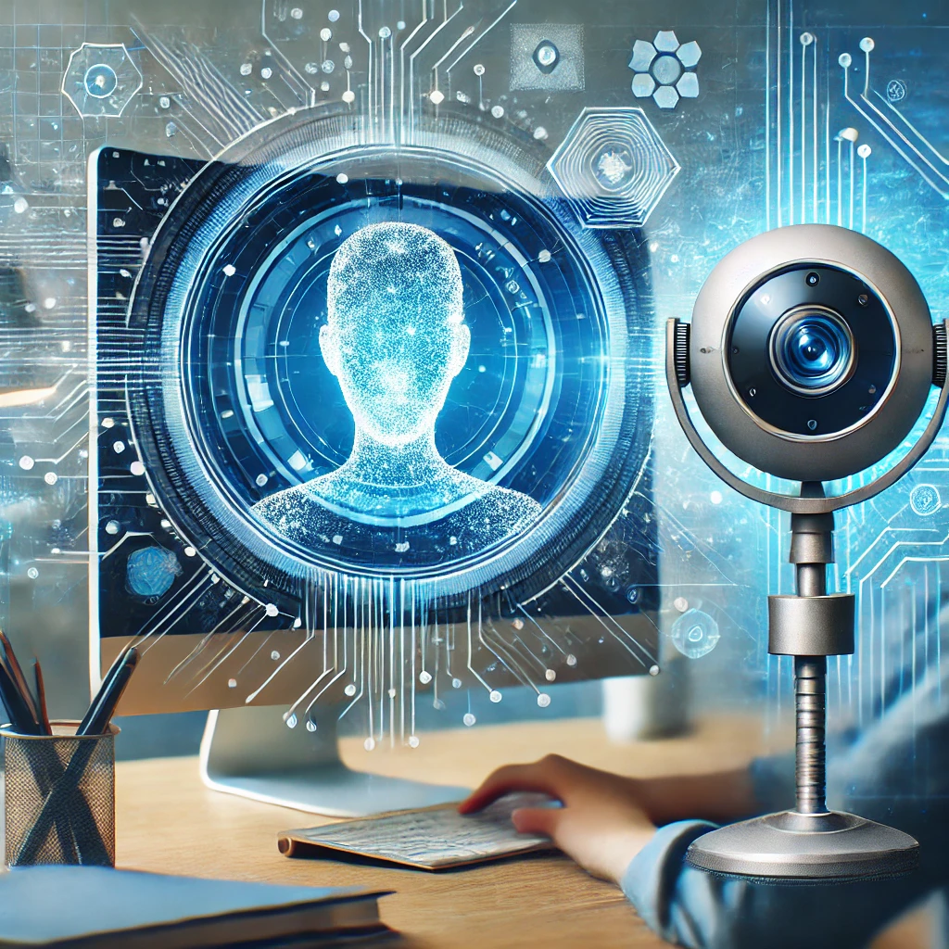
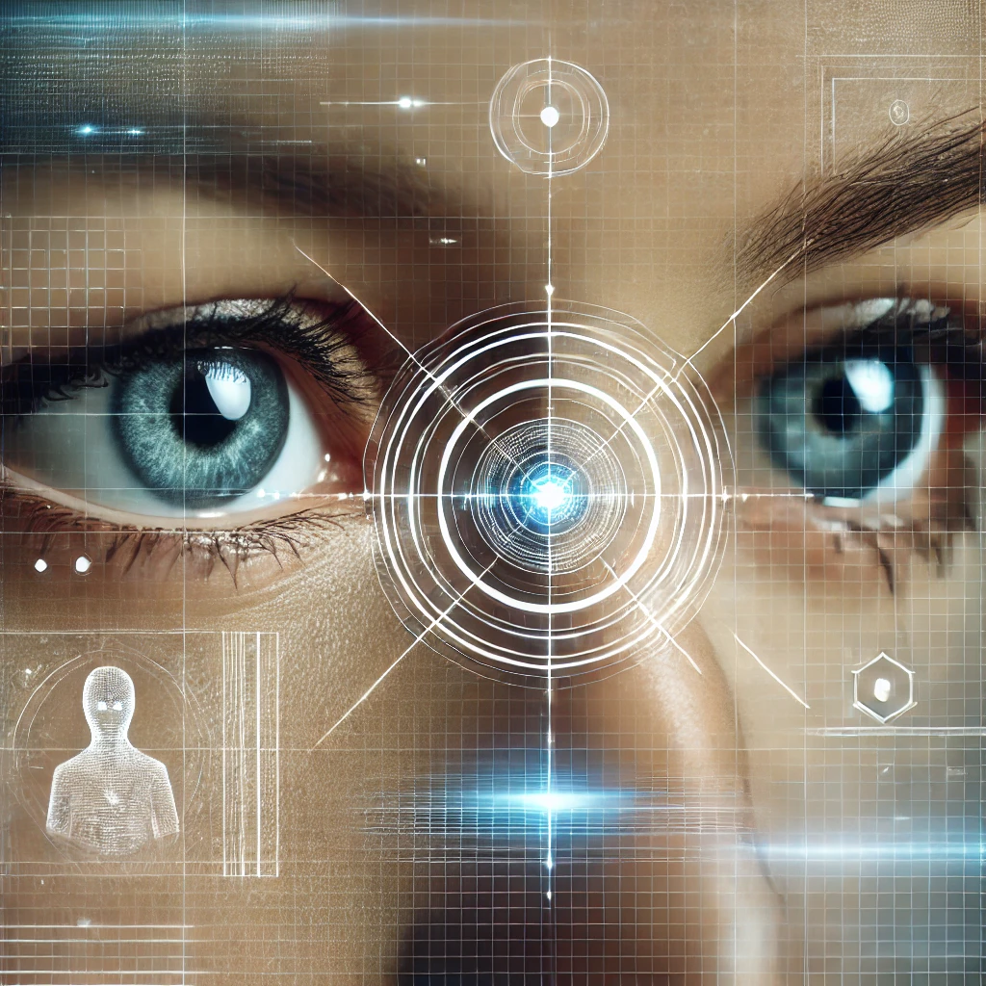
Mini project - presentation on “Drowsiness Detection System”
Presented by: Under the Guidance of:
AMRUTHA B V (4AI22CD003) Prof. Pallavi C S
ANANYA B K (4AI22CD004)
BHUMIKA K (4AI22CD009)
HITHA B R (4AI22CD026)

Slide 2

PROBLEM STATEMENT
With the rise of online education, it's increasingly difficult for instructors to monitor student engagement. Drowsiness in online classes can significantly affect student performance and learning retention.AI-powered tools such as computer vision algorithms can help monitor and detect drowsiness automatically. It focus on how the shift to online education has created challenges for monitoring students, and how technology can address these issues.

Slide 3
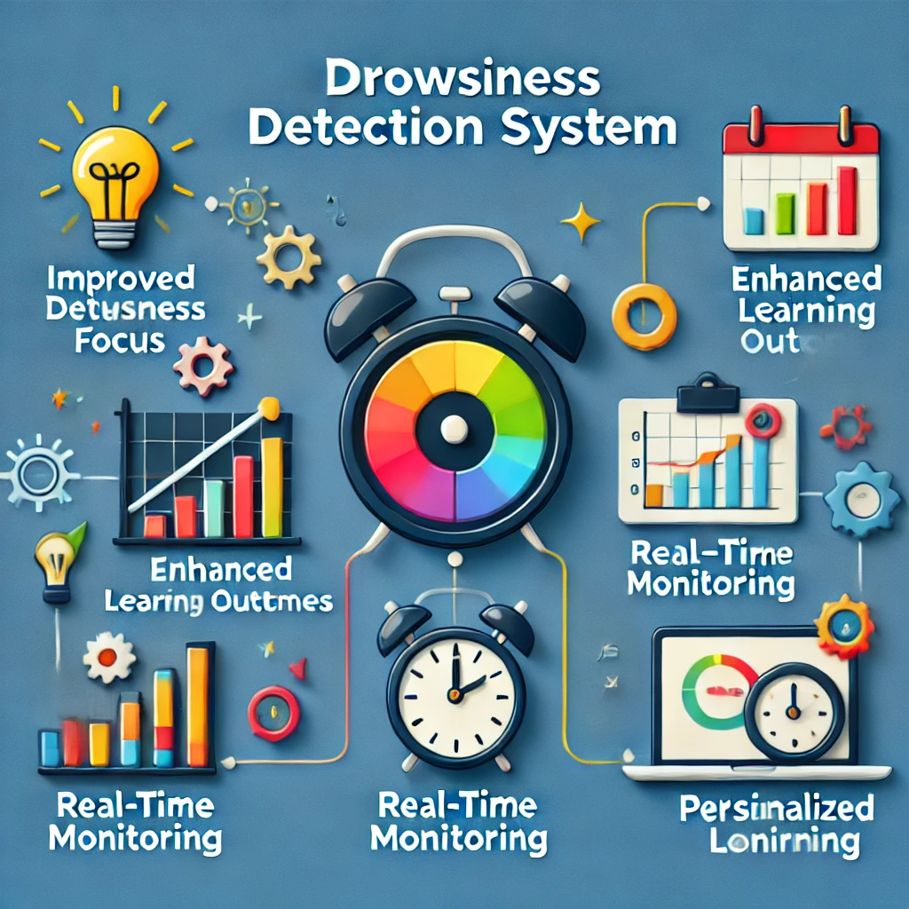
SCOPE OF THE PROJECT
Monitor Eye Movements: Detect signs of drowsiness by tracking eye movements and calculating the Eye Aspect Ratio (EAR).
Real-Time Alerts: Provide immediate visual or auditory alerts when drowsiness is detected to re-engage users.
Enhance Focus and Engagement: Improve student attention and participation in online education by preventing fatigue-related distractions.
Automate Monitoring: Utilize AI and computer vision to automate the detection of drowsiness, reducing manual intervention.
Provide Personalized Feedback: Offer tailored alerts to individuals based on real-time monitoring of their attentiveness.

Slide 4
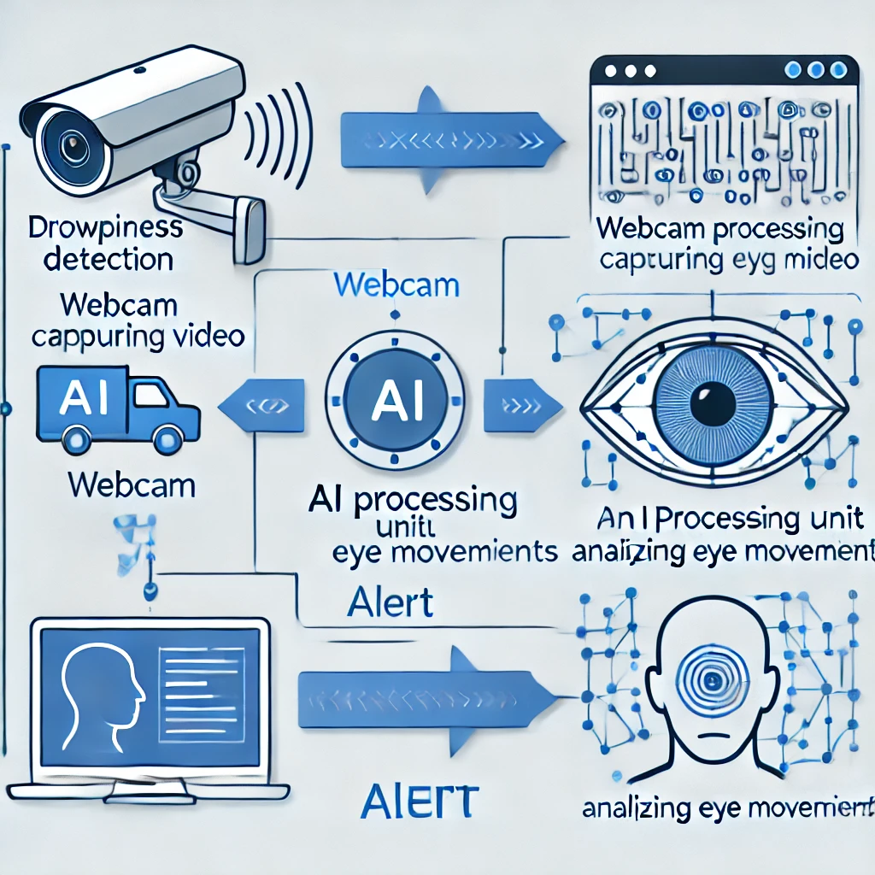
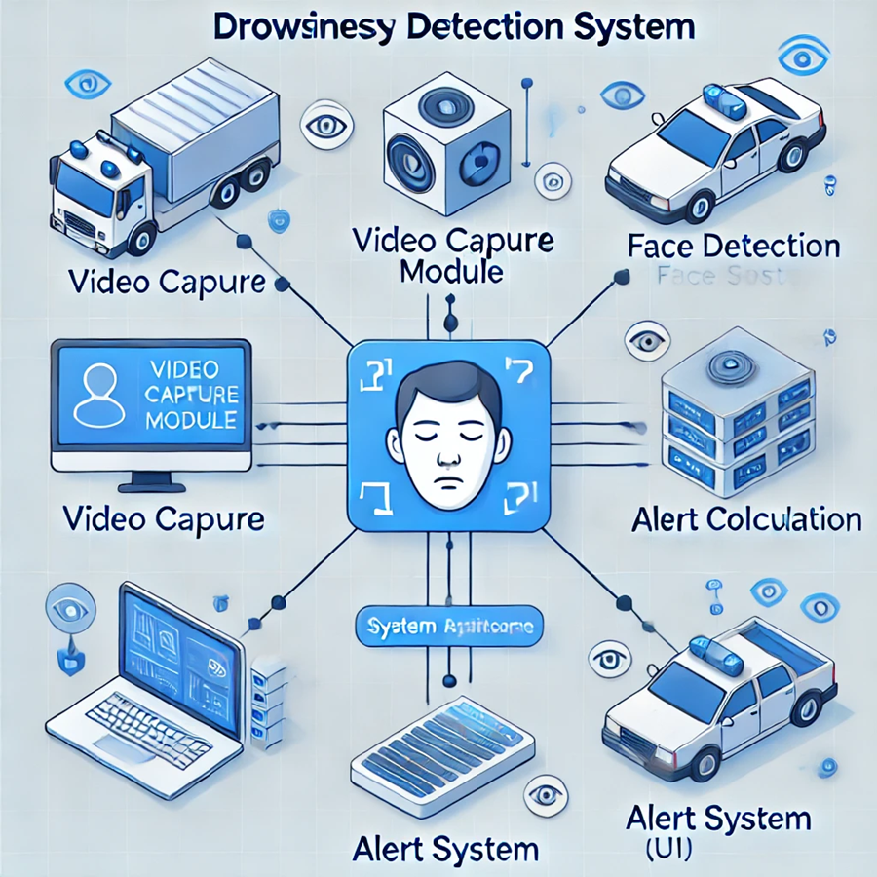
METHODOLOGY
Significance:
Enhances Focus: Improves attention during online learning.
Real-Time Feedback: Provides instant alerts to prevent distractions.
Personalized Alerts: Tailored visual and audio alerts for drowsiness.
Improves Learning Outcomes: Reduces fatigue and boosts retention.
Methodology:
Video Capture: Stream video via OpenCV.
Face Detection: Use MediaPipe to track eye landmarks.
EAR Calculation: Calculate Eye Aspect Ratio to detect drowsiness.
Drowsiness Detection: Trigger alert when EAR falls below threshold.
Alert System: Use Pygame for visual and audio alerts.
This approach ensures continuous monitoring with real-time intervention.

Slide 5
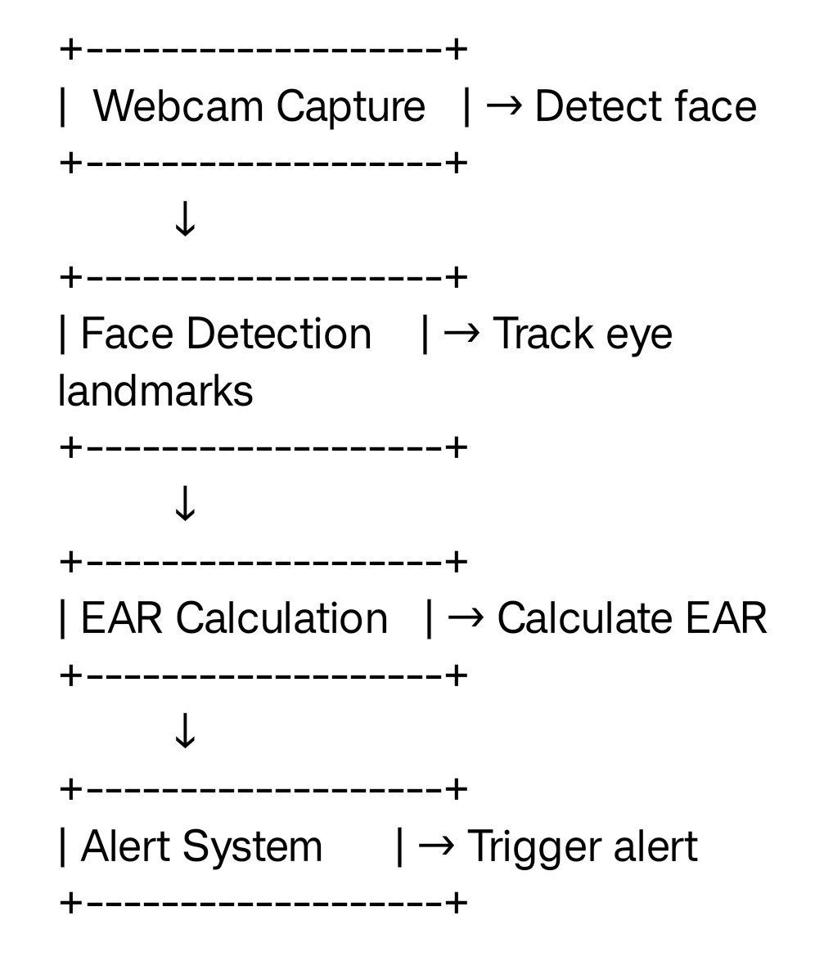
BLOCK DIAGRAM

Slide 6
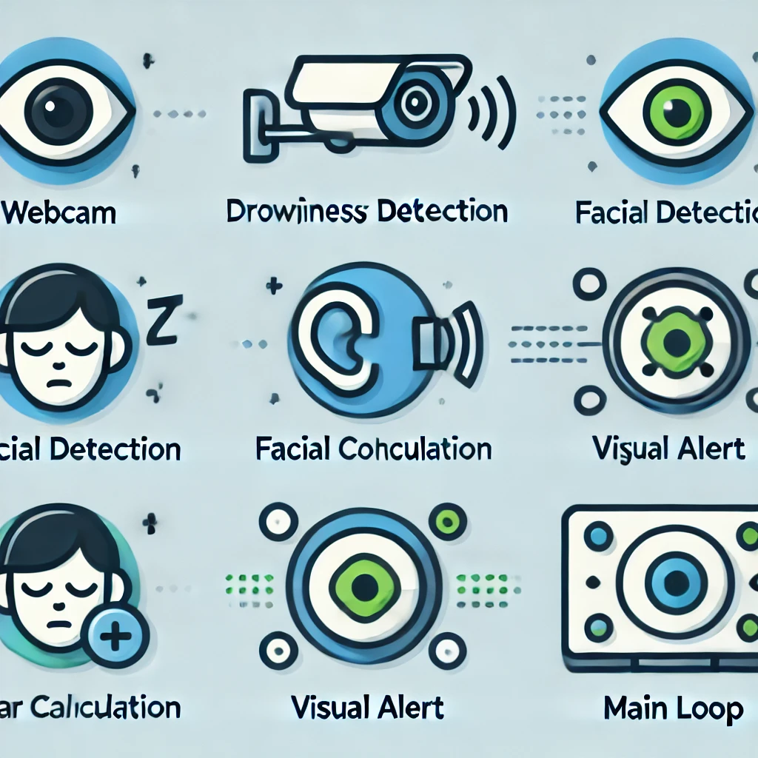
System Design
The Drowsiness Detection System consists of hardware and software components that
work together to monitor student attentiveness in real-time.
Key Components:
Hardware: Webcam for video capture.
Software: Python for core functionality. OpenCV and MediaPipe for facial landmark detection
and eye aspect ratio (EAR) calculation. Pygame for visual/audioalerts.
System Flow:
Video Capture:
Continuous webcam feed.
Face Detection: Identifies facial landmarks (eyes).
EAR Calculation: Monitors eye aspect ratio for signs of drowsiness.
Alert Mechanism: Triggers visual and auditory alerts when EAR is below a threshold.
Output: Real-time feedback through pop-up alerts or sound.

Slide 7

Module Design
Webcam Capture: Continuously captures live video feed.
Landmark Detection: Uses MediaPipe to detect facial landmarks for EAR calculation.
EAR Calculation: Computes Eye Aspect Ratio (EAR) to detect drowsiness.
Alert System: Triggers visual or audio alerts when EAR drops below threshold.
Main Loop: Coordinates all modules for real-time processing and feedback.
This modular design ensures smooth, real-time monitoring and alerts.

Slide 8
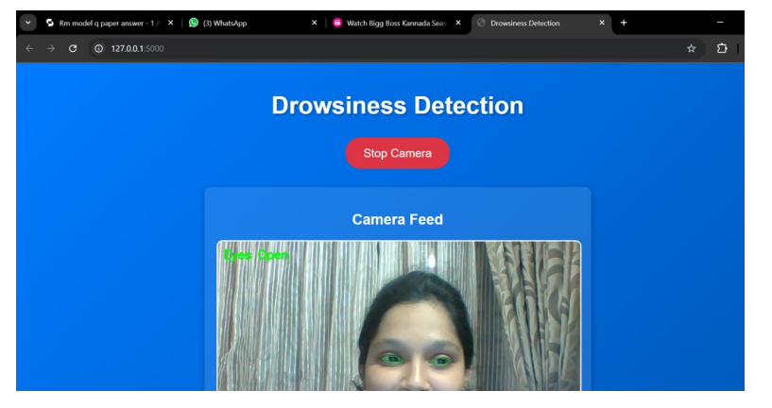
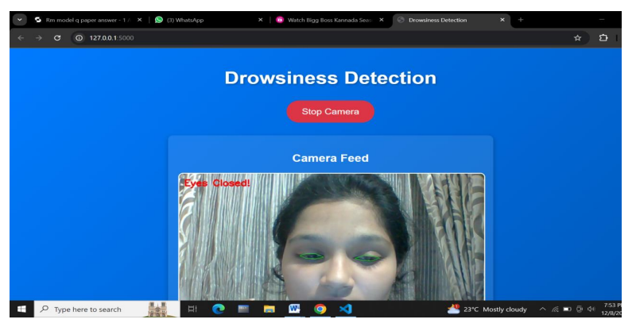
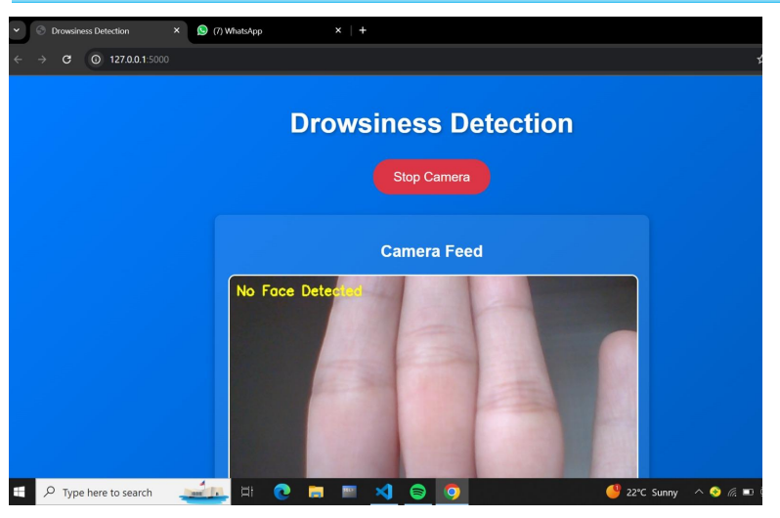
IMPLEMENTATION
The Drowsiness Detection System uses Python with OpenCV for video capture and MediaPipe for detecting facial landmarks. The Eye Aspect Ratio (EAR) is calculated to monitor drowsiness, and if EAR falls below a threshold, the system triggers visual and audio alerts via Pygame. This ensures real-time monitoring and feedback.

Slide 9
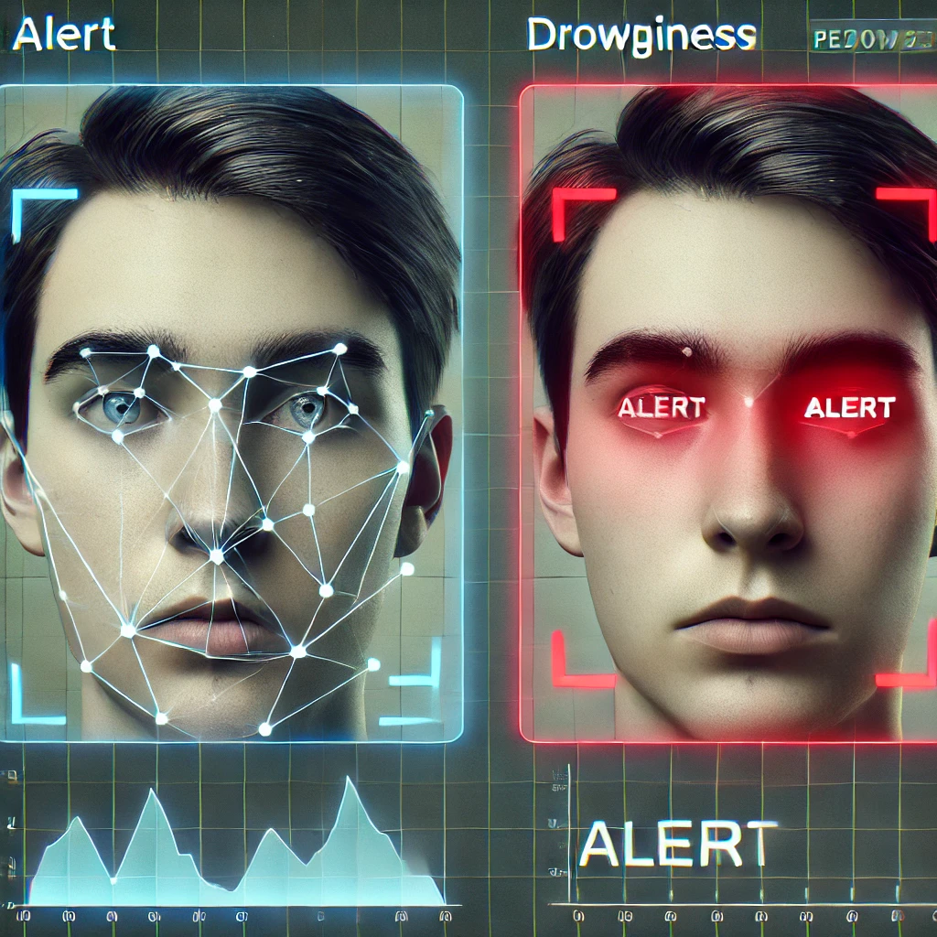
Testing
Lighting Conditions:
Test system performance under
different lighting (bright/dim) to
ensure accurate eye detection.
EAR Threshold Accuracy:
Validate the EAR threshold to
ensure proper drowsiness
detection when EAR drops below
a set value.
Face Occlusions:
Test with occlusions
(glasses, hands) to check
detection accuracy and error
handling.
Alert System Response:
Ensure timely visual and audio
alerts are triggered when
drowsiness is detected.
These tests ensure accuracy, reliability,
and real-time responsiveness
of the system.

Slide 10
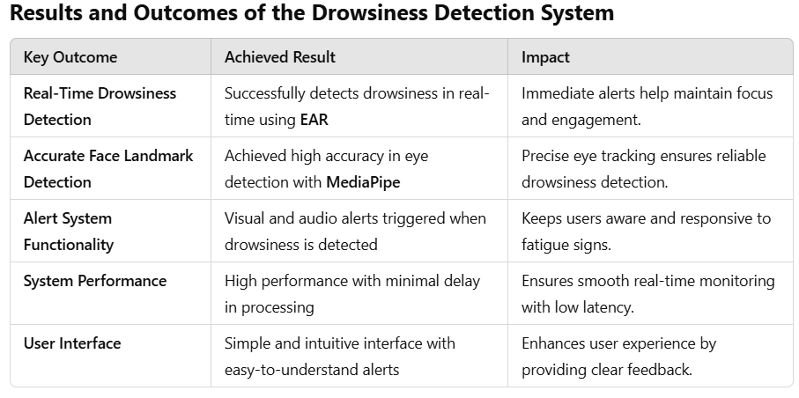
RESULT

Slide 11
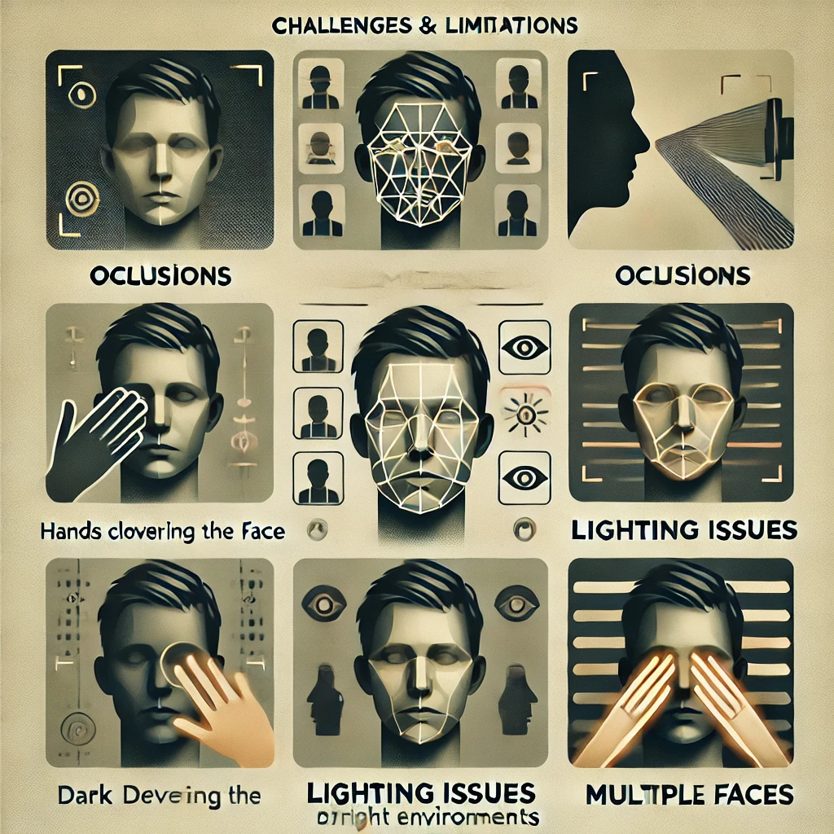
DISCUSSION
Challenges Faced: Lighting Variations: Poor lighting conditions affect the accuracy of facial landmark detection.
Occlusions: Objects like glasses or hands can block the face, making detection difficult.
Limitations: Single-Face Detection: The system only detects one user at a time.
Fixed EAR Threshold: The system uses a static EAR threshold, which may not be accurate for all individuals.
Future Enhancements: Multi-Face Detection: Implement detection for multiple faces to monitor more than one user.
Mobile Compatibility: Adapt the system for use on mobile devices and edge computing platforms

Slide 12
Conclusion
Effective Real-Time Detection: Accurately detects drowsiness through
continuous monitoring of eye movement and EAR (Eye Aspect Ratio).
Immediate Alerts: Triggers both visual and audio alerts when drowsiness is
detected, ensuring quick intervention.
Enhanced User Engagement: Helps maintain user focus and engagement,
especially in online learning or long-duration tasks.
Improved Learning Outcomes: Reduces distractions and enhances retention
by keeping users attentive.
Scalable for Future Use: Potential for adding multi-face detection and mobile
compatibility to expand system capabilities.
Practical Implementation: Provides an accessible and efficient solution for
real-time drowsiness detection in various environments.

Slide 13
Git-hub links
https://github.com/bhumi3672/mm
https://github.com/bvamrutha/drowsiness-detection
https://github.com/Ananya-BK/Drowsiness-detection
https://github.com/hithabalur/Drowsiness-Detection

Slide 14

THANK YOU

